Slide 1
W99702 2D Graphics Engine
Programming and API
Walter Tseng
2004/09/29

Slide 2
Outline
Background of W99702 Graphics Engine
Graphics Engine Programming
Graphics Library API and Samples

Slide 3
Background of W99702 Graphics Engine

Slide 4
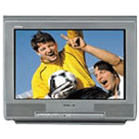
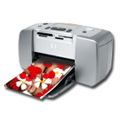

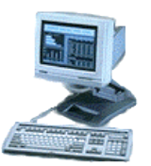

Sensor
Module
TV
Encoder
Memory Buffer
Sensor
DSP
VCE
LCM1
VPOST
BB
ARM9
CPU
JPEG
MPEG4
LCM2
HIC
2D GE
VPE
Audio
APB
FMI
USB
High Speed UART
Configurable SPI
GPIO
PWM
NAND

Slide 5
W99702 Display System
Capture
Video Buffer
VPE
VPOST
LCM
Host
Graphics (OSD)
Buffer
Overlay
Control
GE
SDRAM

Slide 6
W99702 Graphics System
X/Y coordination starts from (0,0)
Can handle resolution up to 2048×2048
Direct color modes only
Color Depth
  8-Bit (RGB332)
  16-Bit (RGB444/RGB565)
  32-Bit (RGB666/RGB888)
R
G
B

Slide 7
W99702 Graphics Operations
33 Filter
BitBLT
Bresenham Line Draw
Rectangle Border Draw

Slide 8
33 Filter
Y Block
Y Block
Filter
U Block
U Block
V Block
V Block
Source Image
Destination Image
Filter Control Parameters

Slide 9
33 Filter Control Parameters
Filter Offset
Filter Coefficients
Filter Clamping Maximum Value
Filter Matrix Divisor

Slide 10
BitBLT Control Parameters
Octant
Source Start Address
Destination Start Address
(SX,SY)
(DX,DY)
Width
Height
Pitch X
Pitch Y

Slide 11
BitBLT Data Copy Directions
Octant Purpose: Avoid Data Corruption
Right-Down
Left-Down
Right-Up
Left-Up
Left-Up Copy

Slide 12
BitBLT Options
Color Expansion
Tile
ROP
Clipping
Transparency
Alpha Blending
Write Mask

Slide 13
ROP (Raster Operation)
Pattern
F(P,S,D)=P
Source
ROP
New
Destination
Destination

Slide 14
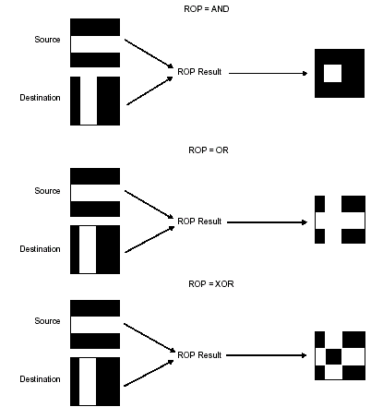

Slide 15
Definition of ROP
P | S | D | F(P,S,D)=DPa
0 | 0 | 0 | 0 (b0)
0 | 0 | 1 | 0 (b1)
0 | 1 | 0 | 0 (b2)
0 | 1 | 1 | 0 (b3)
1 | 0 | 0 | 0 (b4)
1 | 0 | 1 | 1 (b5)
1 | 1 | 0 | 0 (b6)
1 | 1 | 1 | 1 (b7)
ROP code of DPa is 0xA0.

Slide 16
Tricks of ROP Implementation
P | S | D | F(P,S,D)
0 | 0 | 0 | b0
0 | 0 | 1 | b1
0 | 1 | 0 | b2
0 | 1 | 1 | b3
1 | 0 | 0 | b4
1 | 0 | 1 | b5
1 | 1 | 0 | b6
1 | 1 | 1 | b7
b0=b1, b2=b3, b4=b5, b6=b7 => No D in a ROP
b0=b4, b1=b5, b2=b6, b3=b7 => No P in a ROP
b0=b2, b1=b3, b4=b6, b5=b7 => No S in a ROP

Slide 17
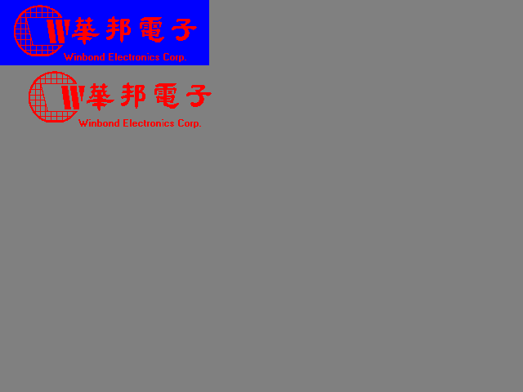
Color Expansion BLT

Slide 18
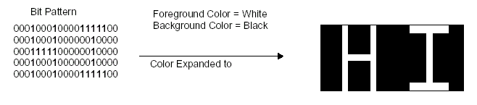

Slide 19
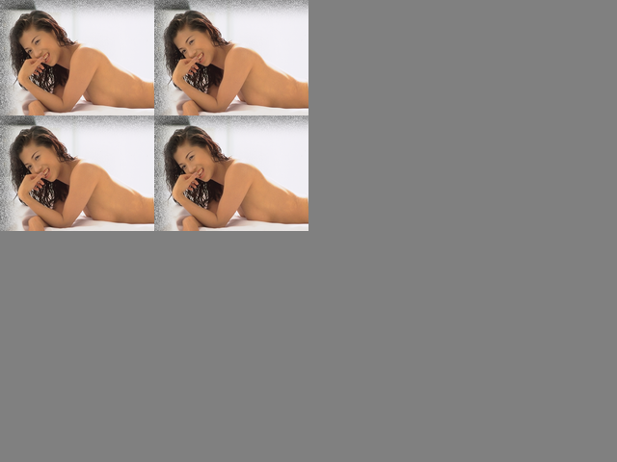
Tile BLT

Slide 20
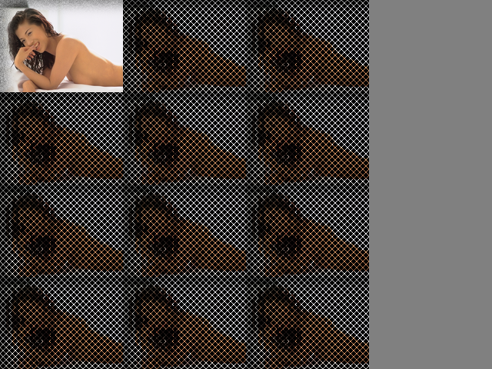
ROP Control

Slide 21


Clipping Control

Slide 22
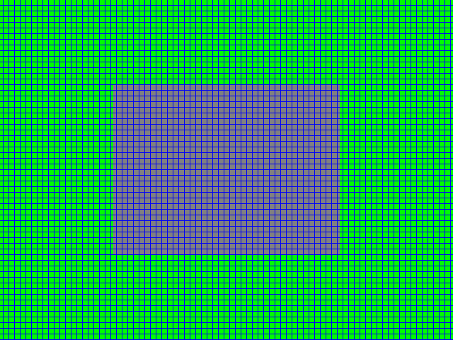
Inside/Outside Clipping

Slide 23

Transparent Control

Slide 24
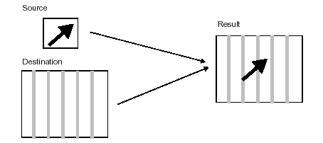

Slide 25

Alpha Blending Control

Slide 26










Slide 27
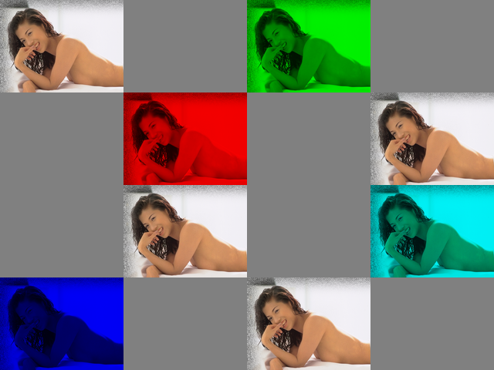
Write Mask Control

Slide 28
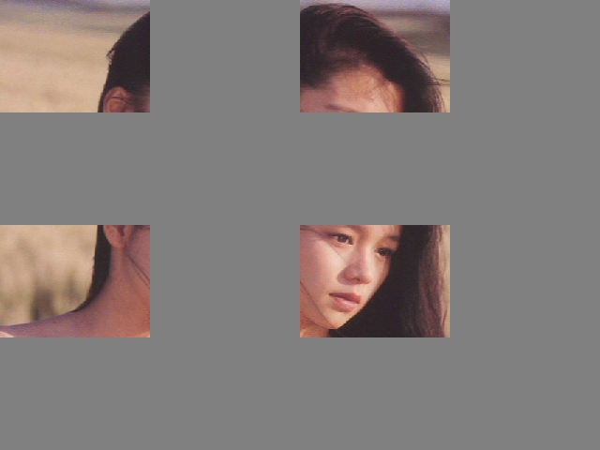
Sprite BLT

Slide 29
Line Draw Control Parameters
See Bresenham Line Drawing Algorithm
Diagonal Error Increment
Axial Error Increment
Initial Error Term
Line Pixel Count Major
Line Style

Slide 30
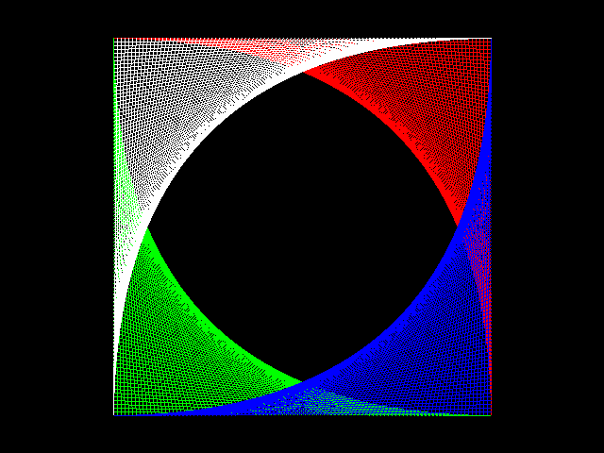
Solid Line Draw

Slide 31
Graphics Engine Programming

Slide 32
Graphics Engine Registers
Register | Address | Description
REG_GE_TRIGGER | 0x7000C000 | Trigger and Tile Control Register
REG_GE_SRC_START00_ADDR REG_GE_FILTER_SRC_ADDR | 0x7000C004 | XY Mode Source Origin Starting Address or Filter Input Image Starting Address
REG_GE_FILTER0 | 0x7000C008 | 33 Filter Central Pixel Coefficient and Matrix Divisor
REG_GE_FILTER1 | 0x7000C00C | 33 Filter Around Pixel Coefficients
REG_GE_INTS | 0x7000C010 | Graphics Engine Interrupt Status
REG_GE_PAT_START_ADDR (Color Pattern Only) | 0x7000C014 | Color Pattern Starting Address
REG_GE_ERR_TERM_STEP_CONST REG_GE_FILTER_THRESHOLD | 0x7000C018 | Bresenham Error Term Stepping Constant or Filter Threshold
REG_GE_INIT_ERR_COUNT | 0x7000C01C | Bresenham Initial Error and Pixel Count Major

Slide 33
Register | Address | Description
REG_GE_CONTROL | 0x7000C020 | Graphics Engine Control Register
REG_GE_BACK_COLOR | 0x7000C024 | Background Color
REG_GE_FORE_COLOR | 0x7000C028 | Foreground Color
REG_GE_TRANSPARENCY_COLOR | 0x7000C02C | Transparency Color
REG_GE_TRANSPARENCY_MASK | 0x7000C030 | Transparency Color Mask
REG_GE_DEST_START00_ADDR REG_GE_FILTER_DEST_ADDR | 0x7000C034 | XY Mode Destination Origin Starting Address or Filter Output Image Address
REG_GE_PITCH REG_GE_FILTER_PITCH | 0x7000C038 | Source/Destination Pitch
REG_GE_SRC_START_ADDR | 0x7000C03C | Source Start XY or Linear Address

Slide 34
Register | Address | Description
REG_GE_DEST_START_ADDR | 0x7000C040 | Destination Start XY or Linear Address
REG_GE_DIMENSION REG_GE_FILTER_DIMENSION | 0x7000C044 | Dimension XY or Linear Address
REG_GE_CLIP_TL | 0x7000C048 | Clipping Boundary Top/Left
REG_GE_CLIP_BR | 0x7000C04C | Clipping Boundary Bottom/Right
REG_GE_PATA (Mono Pattern Only) | 0x7000C050 | Mono Pattern A
REG_GE_PATB (Mono Pattern Only) | 0x7000C054 | Mono Pattern B
REG_GE_WRITE_MASK | 0x7000C058 | Write Plane Mask
REG_GE_MISC | 0x7000C05C | Miscellaneous Control
REG_GE_DATA_PORT0 ~ REG_GE_DATA_PORT7 | 0x7000C060 ~ 0x7000C07C | HostBLT Data Port

Slide 35
REG_GE_TRIGGER
(0x7000C000)
31 | 30 | 29 | 28 | 27 | 26 | 25 | 24
Tile Y
23 | 22 | 21 | 20 | 19 | 18 | 17 | 16
Tile X
15 | 14 | 13 | 12 | 11 | 10 | 9 | 8
Clamping Value
7 | 6 | 5 | 4 | 3 | 2 | 1 | 0
Reserved |  |  |  |  |  |  | Go

Slide 36
REG_GE_SRC_START00_ADDR
(0x7000C004)
31 | 30 | 29 | 28 | 27 | 26 | 25 | 24
XY Mode Source Origin Starting Address [27:24]
23 | 22 | 21 | 20 | 19 | 18 | 17 | 16
XY Mode Source Origin Starting Address [23:16]
15 | 14 | 13 | 12 | 11 | 10 | 9 | 8
XY Mode Source Origin Starting Address [15:8]
7 | 6 | 5 | 4 | 3 | 2 | 1 | 0
XY Mode Source Origin Starting Address [7:0]

Slide 37
REG_GE_FILTER_SRC_ADDR
(0x7000C004)
31 | 30 | 29 | 28 | 27 | 26 | 25 | 24
Filter Input Image Starting Address [27:24]
23 | 22 | 21 | 20 | 19 | 18 | 17 | 16
Filter Input Image Starting Address [23:16]
15 | 14 | 13 | 12 | 11 | 10 | 9 | 8
Filter Input Image Starting Address [15:8]
7 | 6 | 5 | 4 | 3 | 2 | 1 | 0
Filter Input Image Starting Address [7:0]

Slide 38
REG_GE_FILTER0
(0x7000C008)
31 | 30 | 29 | 28 | 27 | 26 | 25 | 24
Filter Offset [7:0]
23 | 22 | 21 | 20 | 19 | 18 | 17 | 16
 | Sign | Central Pixel Coefficient
15 | 14 | 13 | 12 | 11 | 10 | 9 | 8
Matrix Divisor [15:8]
7 | 6 | 5 | 4 | 3 | 2 | 1 | 0
Matrix Divisor [7:0]

Slide 39
REG_GE_FILTER1
(0x7000C00C)
31 | 30 | 29 | 28 | 27 | 26 | 25 | 24
Coefficient 0 |  |  |  | Coefficient 1
23 | 22 | 21 | 20 | 19 | 18 | 17 | 16
Coefficient 2 |  |  |  | Coefficient 3
15 | 14 | 13 | 12 | 11 | 10 | 9 | 8
Coefficient 5 |  |  |  | Coefficient 6
7 | 6 | 5 | 4 | 3 | 2 | 1 | 0
Coefficient 7 |  |  |  | Coefficient 8

Slide 40
REG_GE_INTS
(0x7000C010)
31 | 30 | 29 | 28 | 27 | 26 | 25 | 24
Reserved
23 | 22 | 21 | 20 | 19 | 18 | 17 | 16
Reserved
15 | 14 | 13 | 12 | 11 | 10 | 9 | 8
Reserved
7 | 6 | 5 | 4 | 3 | 2 | 1 | 0
Reserved |  |  |  |  |  |  | INTS

Slide 41
REG_GE_PAT_START_ADDR
(0x7000C014)
31 | 30 | 29 | 28 | 27 | 26 | 25 | 24
Color Pattern Starting Address [27:24]
23 | 22 | 21 | 20 | 19 | 18 | 17 | 16
Color Pattern Starting Address [23:16]
15 | 14 | 13 | 12 | 11 | 10 | 9 | 8
Color Pattern Starting Address [15:8]
7 | 6 | 5 | 4 | 3 | 2 | 1 | 0
Color Pattern Starting Address [7:0]

Slide 42
REG_GE_ERR_TERM_STEP_CONST
(0x7000C018)
31 | 30 | 29 | 28 | 27 | 26 | 25 | 24
Diagonal Error Increment [13:8]
23 | 22 | 21 | 20 | 19 | 18 | 17 | 16
Diagonal Error Increment [7:0]
15 | 14 | 13 | 12 | 11 | 10 | 9 | 8
Axial Error Increment [13:8]
7 | 6 | 5 | 4 | 3 | 2 | 1 | 0
Axial Error Increment [7:0]

Slide 43
REG_GE_INIT_ERR_COUNT
(0x7000C01C)
31 | 30 | 29 | 28 | 27 | 26 | 25 | 24
Initial Error Term [13:8]
23 | 22 | 21 | 20 | 19 | 18 | 17 | 16
Initial Error Term [7:0]
15 | 14 | 13 | 12 | 11 | 10 | 9 | 8
Line Pixel Count Major – 1 [13:8]
7 | 6 | 5 | 4 | 3 | 2 | 1 | 0
Line Pixel Count Major – 1 [7:0]

Slide 44
REG_GE_FILTER_THRESHOLD
(0x7000C01C)
31 | 30 | 29 | 28 | 27 | 26 | 25 | 24
Reserved
23 | 22 | 21 | 20 | 19 | 18 | 17 | 16
Reserved
15 | 14 | 13 | 12 | 11 | 10 | 9 | 8
Reserved
7 | 6 | 5 | 4 | 3 | 2 | 1 | 0
Filter Threshold [7:0]

Slide 45
REG_GE_CONTROL
(0x7000C020)
31 | 30 | 29 | 28 | 27 | 26 | 25 | 24
ROP
23 | 22 | 21 | 20 | 19 | 18 | 17 | 16
CMD |  | ALPHA | STYLED LINE | M/D | LASTP | INT | ADDR MODE
15 | 14 | 13 | 12 | 11 | 10 | 9 | 8
TRANSPARENCY |  | MTS | CTS | CTP | AU TILE | CLIP | CLPC
7 | 6 | 5 | 4 | 3 | 2 | 1 | 0
SDT | SRCS |  | PDT | XY OCTANT |  |  | DDTO

Slide 46
Graphics Command (CMD)
Controlled by CRC020 Bit 23~22
00: 3×3 Filter
01: BitBLT
10: Line Draw
11: Rectangle Border Draw

Slide 47
Addressing Mode
(ADDR MODE)
Controlled by CRC020 Bit 16
0: Linear Addressing Mode
1: XY Addressing Mode
In linear addressing mode the origin starting address will always be 0. It can be used for memory to memory DMA implementation.

Slide 48
Transparency Control
Controlled by CRC020 Bit 15~14
00: Disable
01: Mono Transparency
10: Color Transparency
11: Reserved

Slide 49
Mono Transparency Selection
(MTS)
Controlled by CRC020 Bit 13
0: Source
1: Pattern

Slide 50
Color Transparency Selection
(CTS)
Controlled by CRC020 Bit 12
0: Source pixels control transparency
1: Destination pixels control transparency

Slide 51
Color Transparency Polarity
(CTP)
Controlled by CRC020 Bit 11
0: Matched pixels are transparent
1: Matched pixels are opaque

Slide 52
Clipping Control (CLPC)
Controlled by CRC020 Bit 8
0: Inside Clipping
1: Outside Clipping

Slide 53
Source Data Type (SDT)
Controlled by CRC020 Bit 7
0: Color
1: Mono
Source and Pattern are not allowed to be both in mono format.

Slide 54
Source Data Select (SRCS)
Controlled by CRC020 Bit 6~5
00: Display Memory
01: System Memory (Data Port)
10: Background Color
11: Foreground Color

Slide 55
Pattern Data Type (PDT)
Controlled by CRC020 Bit 4
0: Color (form Pattern Buffer)
1: Mono (from Pattern Registers)

Slide 56
XY OCTANT
OCTANT | BitBLT | Line Draw
000 | Right-Down | +X, +Y, X Major
001 | Right-Down | +X, +Y, Y Major
010 | Left-Down | +X, -Y, X Major
011 | Left-Down | +X, -Y, Y Major
100 | Right-Up | -X, +Y, X Major
101 | Right-Up | -X, +Y, Y Major
110 | Left-Up | -X, -Y, X Major
111 | Left-Up | -X, -Y, Y Major

Slide 57
Destination Data To
(DDTO)
Controlled by CRC020 Bit 0
0: Display Memory
1: System Memory (Data Port)

Slide 58
Screen-To-Screen Operation
SDRAM
Graphics
Engine
ARM9
VPOST
HBI
LCD
Host

Slide 59
Host-To-Screen Operation
SDRAM
Graphics
Engine
ARM9
VPOST
HBI
LCD
Host

Slide 60
Screen-To-Host Operation
Data Port
SDRAM
Graphics
Engine
ARM9
VPOST
HBI
LCD
Host

Slide 61
REG_GE_BACK_COLOR
(0x7000C024)
31 | 30 | 29 | 28 | 27 | 26 | 25 | 24
Reserved
23 | 22 | 21 | 20 | 19 | 18 | 17 | 16
Background Color [23:16]
15 | 14 | 13 | 12 | 11 | 10 | 9 | 8
Background Color [15:8]
7 | 6 | 5 | 4 | 3 | 2 | 1 | 0
Background Color [7:0]

Slide 62
REG_GE_FORE_COLOR
(0x7000C028)
31 | 30 | 29 | 28 | 27 | 26 | 25 | 24
Reserved
23 | 22 | 21 | 20 | 19 | 18 | 17 | 16
Foreground Color [23:16]
15 | 14 | 13 | 12 | 11 | 10 | 9 | 8
Foreground Color [15:8]
7 | 6 | 5 | 4 | 3 | 2 | 1 | 0
Foreground Color [7:0]

Slide 63
REG_GE_TRANSPARENCY_COLOR
(0x7000C02C)
31 | 30 | 29 | 28 | 27 | 26 | 25 | 24
Reserved
23 | 22 | 21 | 20 | 19 | 18 | 17 | 16
Transparency Color [23:16]
15 | 14 | 13 | 12 | 11 | 10 | 9 | 8
Transparency Color [15:8]
7 | 6 | 5 | 4 | 3 | 2 | 1 | 0
Transparency Color [7:0]

Slide 64
REG_GE_TRANSPARENCY_MASK
(0x7000C030)
31 | 30 | 29 | 28 | 27 | 26 | 25 | 24
Reserved
23 | 22 | 21 | 20 | 19 | 18 | 17 | 16
Transparency Color Mask [23:16]
15 | 14 | 13 | 12 | 11 | 10 | 9 | 8
Transparency Color Mask [15:8]
7 | 6 | 5 | 4 | 3 | 2 | 1 | 0
Transparency Color Mask [7:0]

Slide 65
REG_GE_DEST_START00_ADDR
(0x7000C034)
31 | 30 | 29 | 28 | 27 | 26 | 25 | 24
XY Mode Destination Origin Starting Address [27:24]
23 | 22 | 21 | 20 | 19 | 18 | 17 | 16
XY Mode Destination Origin Starting Address [23:16]
15 | 14 | 13 | 12 | 11 | 10 | 9 | 8
XY Mode Destination Origin Starting Address [15:8]
7 | 6 | 5 | 4 | 3 | 2 | 1 | 0
XY Mode Destination Origin Starting Address [7:0]

Slide 66
REG_GE_FILTER_DEST_ADDR
(0x7000C034)
31 | 30 | 29 | 28 | 27 | 26 | 25 | 24
Filter Output Image Starting Address [27:24]
23 | 22 | 21 | 20 | 19 | 18 | 17 | 16
Filter Output Image Starting Address [23:16]
15 | 14 | 13 | 12 | 11 | 10 | 9 | 8
Filter Output Image Starting Address [15:8]
7 | 6 | 5 | 4 | 3 | 2 | 1 | 0
Filter Output Image Starting Address [7:0]

Slide 67
REG_GE_PITCH
(0x7000C038)
31 | 30 | 29 | 28 | 27 | 26 | 25 | 24
Destination Pitch [12:8]
23 | 22 | 21 | 20 | 19 | 18 | 17 | 16
Destination Pitch [7:0]
15 | 14 | 13 | 12 | 11 | 10 | 9 | 8
Source Pitch [12:8]
7 | 6 | 5 | 4 | 3 | 2 | 1 | 0
Source Pitch [7:0]

Slide 68
REG_GE_SRC_START_ADDR
(0x7000C03C)
31 | 30 | 29 | 28 | 27 | 26 | 25 | 24
Source Start Y [10:8] / Source Linear Address [27:24]
23 | 22 | 21 | 20 | 19 | 18 | 17 | 16
Source Start Y [7:0] / Source Linear Address [23:16]
15 | 14 | 13 | 12 | 11 | 10 | 9 | 8
Source Start X [10:8] / Source Linear Address [15:8]
7 | 6 | 5 | 4 | 3 | 2 | 1 | 0
Source Start X [7:0] / Source Linear Address [7:0]

Slide 69
REG_GE_DEST_START_ADDR
(0x7000C040)
31 | 30 | 29 | 28 | 27 | 26 | 25 | 24
Destination Start Y [10:8] / Destination Linear Address [27:24]
23 | 22 | 21 | 20 | 19 | 18 | 17 | 16
Destination Start Y [7:0] / Destination Linear Address [23:16]
15 | 14 | 13 | 12 | 11 | 10 | 9 | 8
Destination Start X [10:8] / Destination Linear Address [15:8]
7 | 6 | 5 | 4 | 3 | 2 | 1 | 0
Destination Start X [7:0] / Destination Linear Address [7:0]

Slide 70
REG_GE_DIMENSION
(0x7000C044)
31 | 30 | 29 | 28 | 27 | 26 | 25 | 24
Dimension Y [10:8] / Linear Mode Destination [27:24]
23 | 22 | 21 | 20 | 19 | 18 | 17 | 16
Dimension Y [7:0] / Linear Mode Destination [23:16]
15 | 14 | 13 | 12 | 11 | 10 | 9 | 8
Dimension X [10:8] / Linear Mode Destination [15:8]
7 | 6 | 5 | 4 | 3 | 2 | 1 | 0
Dimension X [7:0] / Linear Mode Destination [7:0]

Slide 71
REG_GE_CLIP_TL
(0x7000C048)
31 | 30 | 29 | 28 | 27 | 26 | 25 | 24
Clipping Boundary Top [10:8]
23 | 22 | 21 | 20 | 19 | 18 | 17 | 16
Clipping Boundary Top [7:0]
15 | 14 | 13 | 12 | 11 | 10 | 9 | 8
Clipping Boundary Left [10:8]
7 | 6 | 5 | 4 | 3 | 2 | 1 | 0
Clipping Boundary Left [7:0]

Slide 72
REG_GE_CLIP_BR
(0x7000C04C)
31 | 30 | 29 | 28 | 27 | 26 | 25 | 24
Clipping Boundary Bottom [10:8]
23 | 22 | 21 | 20 | 19 | 18 | 17 | 16
Clipping Boundary Bottom [7:0]
15 | 14 | 13 | 12 | 11 | 10 | 9 | 8
Clipping Boundary Right [10:8]
7 | 6 | 5 | 4 | 3 | 2 | 1 | 0
Clipping Boundary Right [7:0]

Slide 73
REG_GE_PATA
(0x7000C050)
31 | 30 | 29 | 28 | 27 | 26 | 25 | 24
Mono Pattern Line 3
23 | 22 | 21 | 20 | 19 | 18 | 17 | 16
Mono Pattern Line 2
15 | 14 | 13 | 12 | 11 | 10 | 9 | 8
Mono Pattern Line 1
7 | 6 | 5 | 4 | 3 | 2 | 1 | 0
Mono Pattern Line 0

Slide 74
REG_GE_PATB
(0x7000C054)
31 | 30 | 29 | 28 | 27 | 26 | 25 | 24
Mono Pattern Line 7
23 | 22 | 21 | 20 | 19 | 18 | 17 | 16
Mono Pattern Line 6
15 | 14 | 13 | 12 | 11 | 10 | 9 | 8
Mono Pattern Line 5
7 | 6 | 5 | 4 | 3 | 2 | 1 | 0
Mono Pattern Line 4

Slide 75
REG_GE_WRITE_MASK
(0x7000C058)
31 | 30 | 29 | 28 | 27 | 26 | 25 | 24
Reserved
23 | 22 | 21 | 20 | 19 | 18 | 17 | 16
Write Plane Mask [23:16]
15 | 14 | 13 | 12 | 11 | 10 | 9 | 8
Write Plane Mask [15:8]
7 | 6 | 5 | 4 | 3 | 2 | 1 | 0
Write Plane Mask [7:0]

Slide 76
REG_GE_MISC
(0x7000C05C)
31 | 30 | 29 | 28 | 27 | 26 | 25 | 24
Line Style Pattern 0 / Alpha Blending Source Ks
23 | 22 | 21 | 20 | 19 | 18 | 17 | 16
Line Style Pattern 1 / Alpha Blending Source Kd
15 | 14 | 13 | 12 | 11 | 10 | 9 | 8
FIFO Status |  |  |  | EMPTY | FULL | BITBLT STS | BUSY
7 | 6 | 5 | 4 | 3 | 2 | 1 | 0
Reserved (Engine Reset) |  | BPP |  | BLT MODE | BLT TYPE

Slide 77
REG_GE_DATA_PORT
(0x7000C060~0x7000C07C)
31 | 30 | 29 | 28 | 27 | 26 | 25 | 24
HostBLT Data [31:24]
23 | 22 | 21 | 20 | 19 | 18 | 17 | 16
HostBLT Data [23:16]
15 | 14 | 13 | 12 | 11 | 10 | 9 | 8
HostBLT Data [15:8]
7 | 6 | 5 | 4 | 3 | 2 | 1 | 0
HostBLT Data [7:0]

Slide 78

Engine Reset

Slide 79

Wait Engine Ready

Slide 80
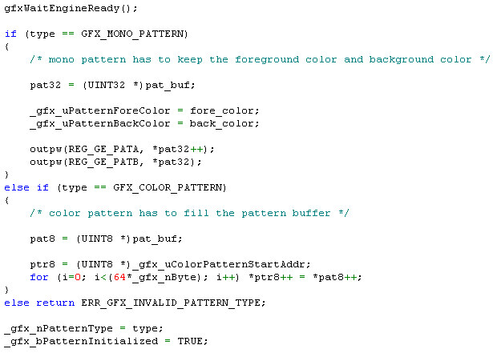
Set Pattern

Slide 81
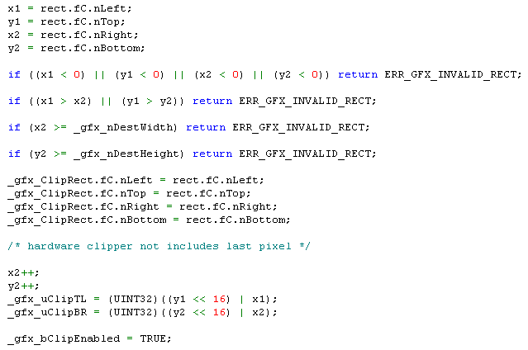
Set Clip

Slide 82
General BitBLT Programming
Specify graphics system parameters
Specify control parameters (ROP / clipping / blending / transparency / color expansion)
Prepare pattern if ROP has P component
Trigger REG_GE_TRIGGER
Read/Write data port if necessary
Wait for command complete

Slide 83
BitBLT Programming Note
Separate source/destination address for Offscreen BLT.
Only 0xCC ROP is allowed for Host Read BLT.
Check source and destination overlay for proper octant programming.
All Host Read BLT and Host Write BLT must be 4-byte boundary.
Ks [0..255] and Kd [0..255] are programmable. Take care of 256 case.

Slide 84
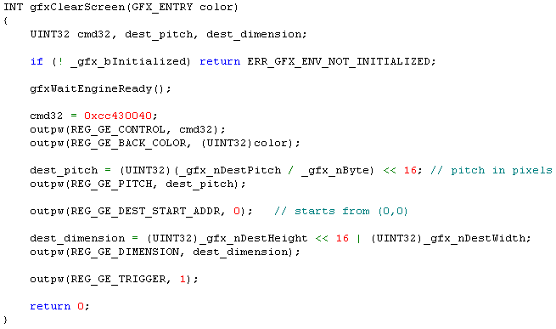
Clear Screen width Solid Fill

Slide 85
3×3 Filter Programming
Can be applied to YUV444 or 422 or 420.
Must be set to 8-bpp mode.
Determination of divisor.
The weighting is signed magnitude. First is the signed bit.
Offset is programmable.
Clamping and Threshold are programmable.
See library source code for detail
See “Memo of W99702 Hardware Filter”

Slide 86
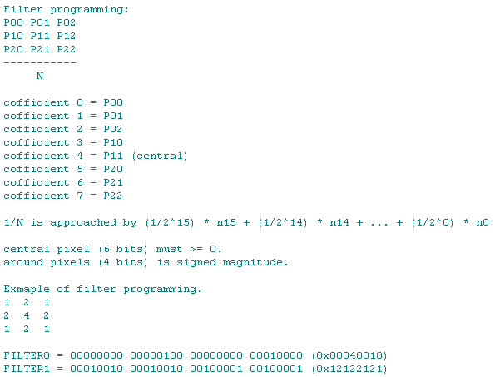

Slide 87
Divisor Programming
Divisor=9
Target=0.111111 (1/9)
0.111084
0001110001110000
divisor programming data=0x1c70

Slide 88
Matrix Programming
Emboss Filter:
0 0 -1
0 0 0
1 0 0
FILTER0 = 0x00000001 (central pixel)
FILTER1 = 0x00900100 (around pixels)

Slide 89

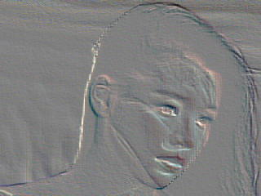
Emboss Filter Result

Slide 90
Line Drawing Programming
Diagonal Error Increment: 2*(min-max)
Axial Error Increment: 2*min
Initial Error Term: 2*min-max
Line Pixel Count Major: max
Line Style
Clipping Rectangle
See library source code for detail

Slide 91
Known Hardware Problems
ROP with S+Color P can’t be supported.
0x00 or 0xFF ROP BLT may halt at some CPU Clock : Engine Clock conditions.

Slide 92
Graphics Engine Library

Slide 93
Graphics Engine Library
Font Library
Graphics Library
VPOST Library
LCM

Slide 94
Buffer Allocation
Video Buffer
VPOST Library
Graphics (OSD) Buffer
Graphics Library
Color Pattern Buffer
Bitmap Buffer

Slide 95
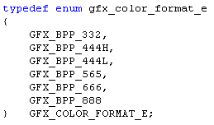
Color Format

Slide 96
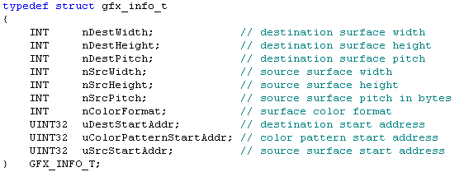
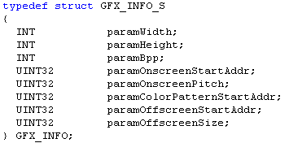
Drawing Environment

Slide 97
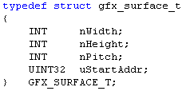
Surface Structure

Slide 98
Surface Control
Display
⬥
Temporal Buffer
◆
❖
Bitmap Buffer 1
Bitmap Buffer 2

Slide 99
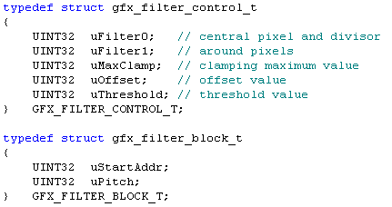
Filter Control

Slide 100
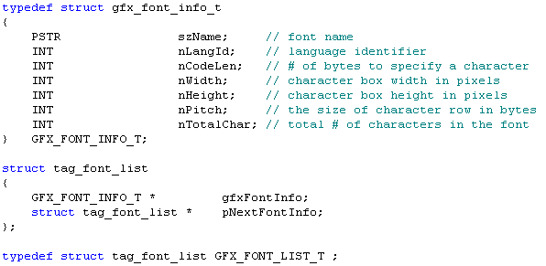
Font Structure

Slide 101
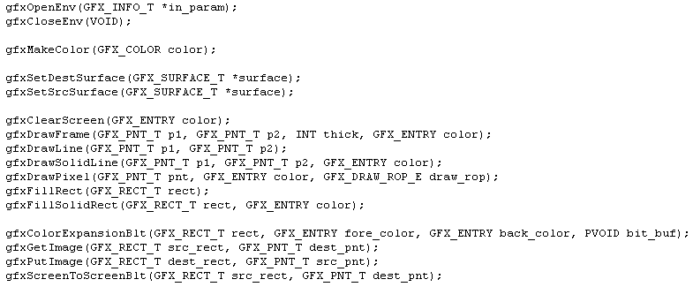
API Overview

Slide 102
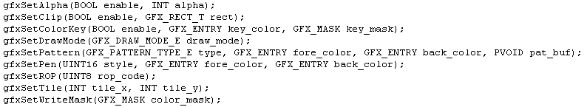


Slide 103
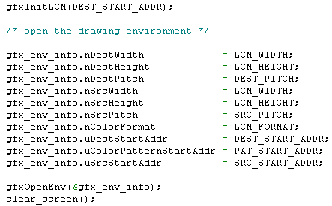
Initialization of Graphics System

Slide 104
Java Acceleration
W99702
(LCM Bridge)
Baseband
GE
LCM
J2ME
MIDP
VPOST
Memory
Buffer
javax.microedition.lcdui

